Slide 1
BME280 vs SHT31
Comparing sensors

Slide 2
Different scenarios

Slide 3
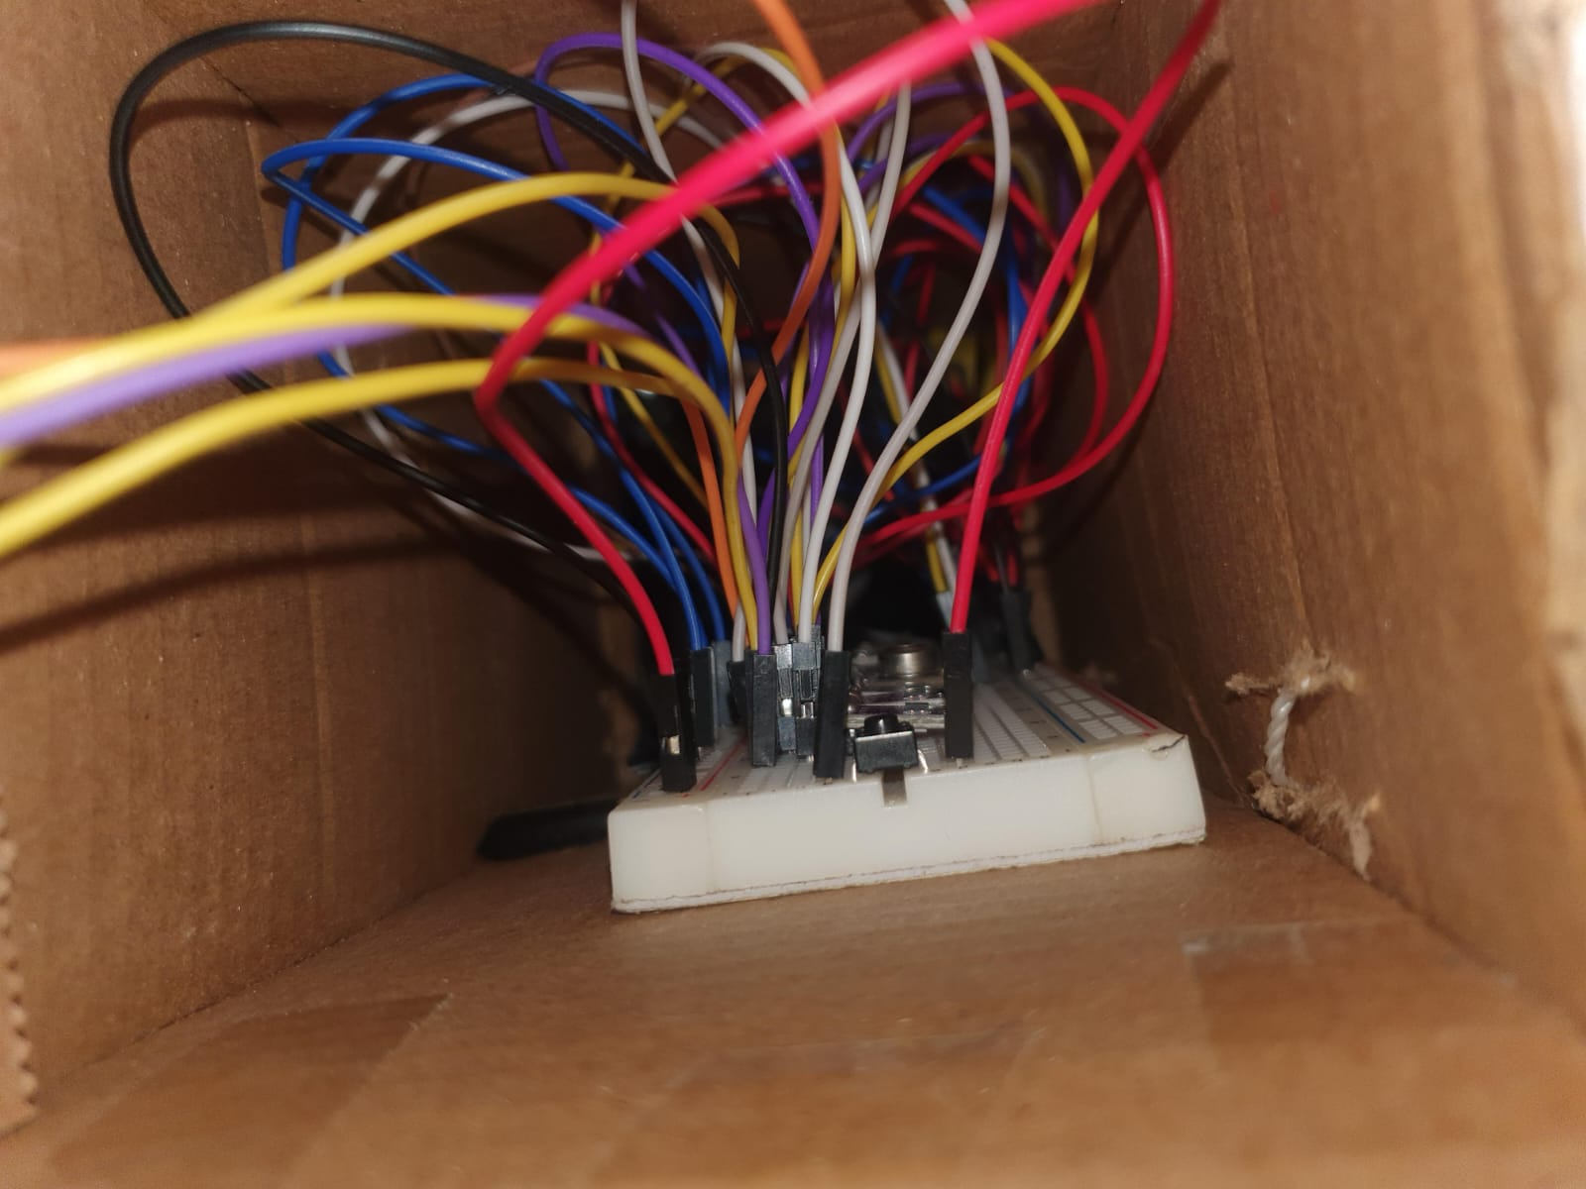
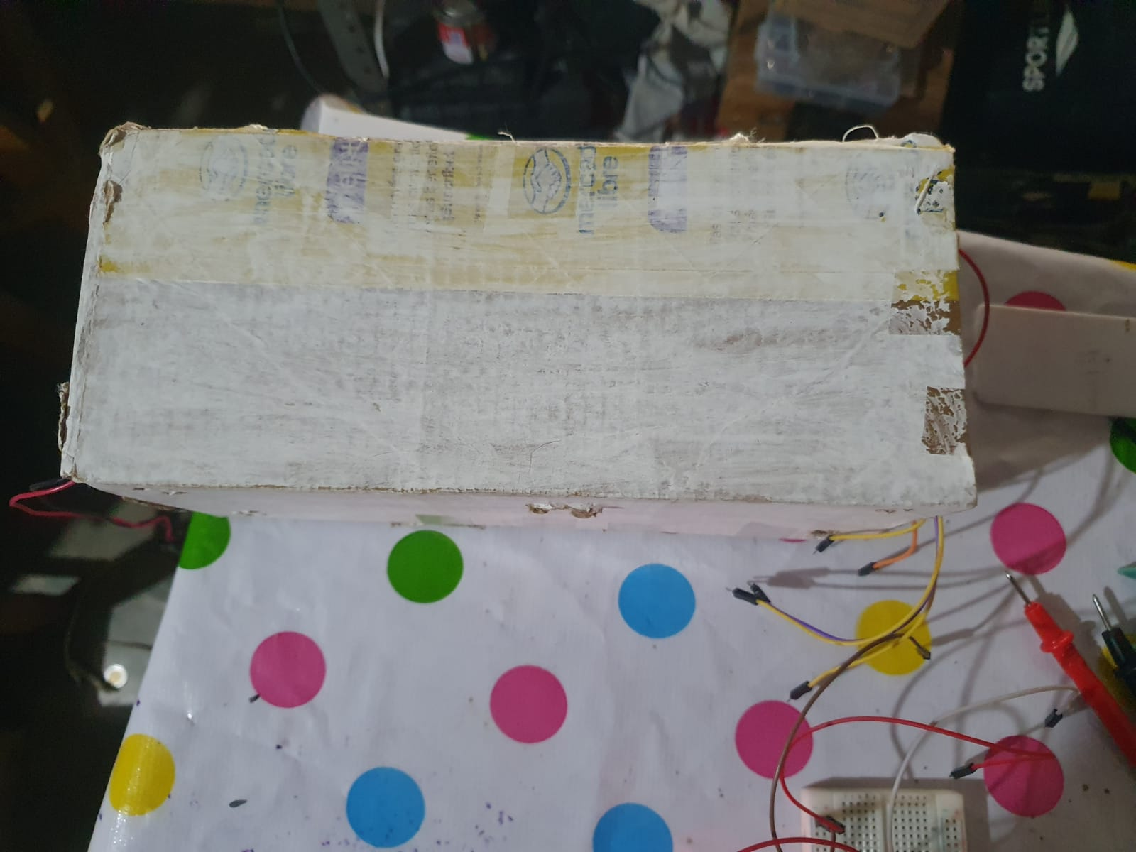
Materials Room

Slide 4
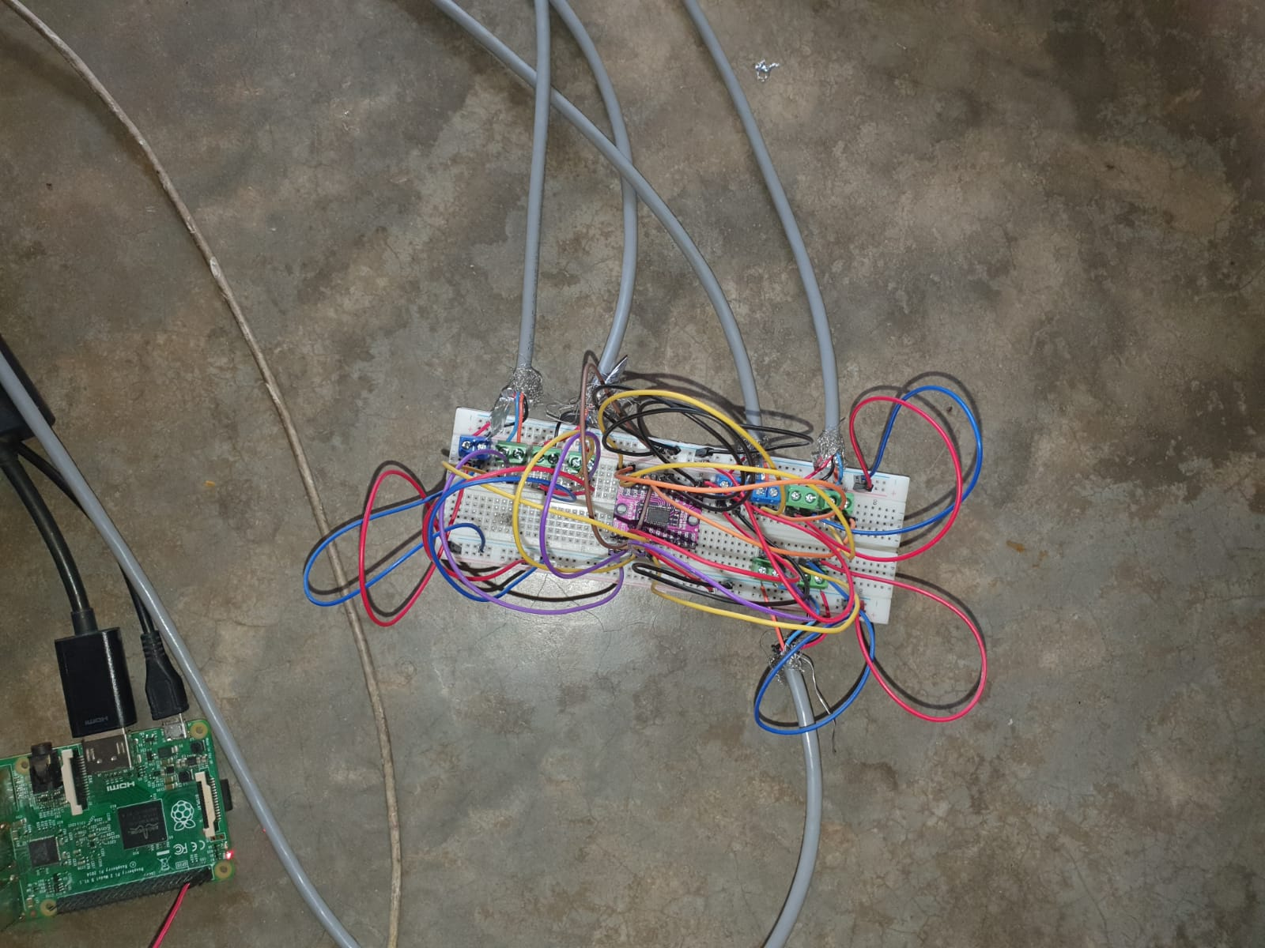
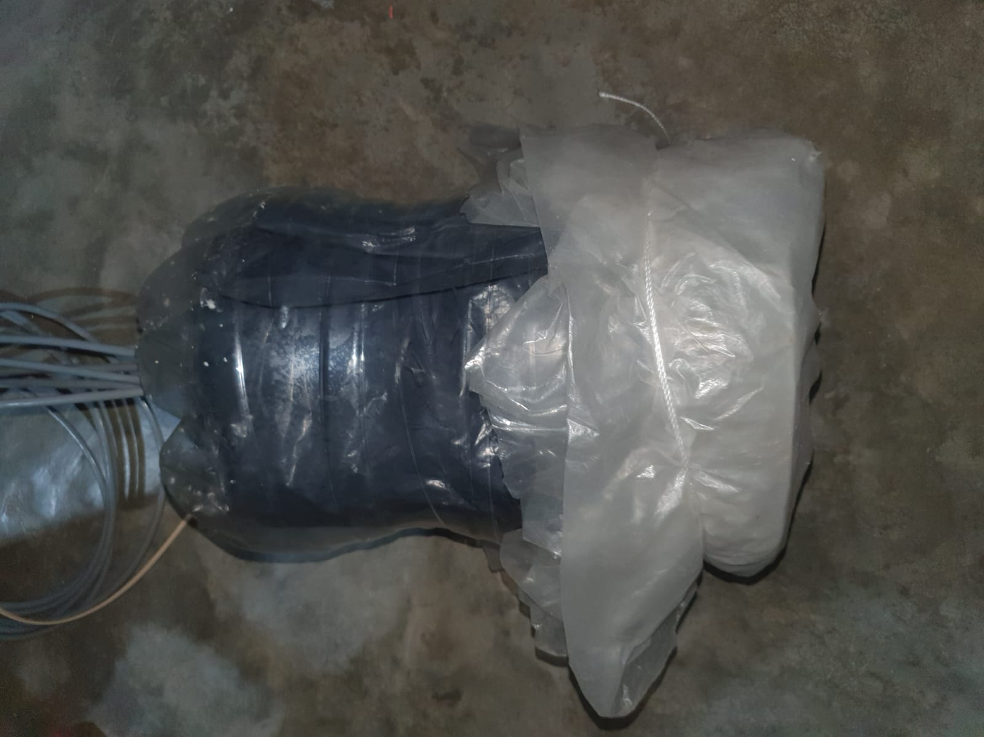
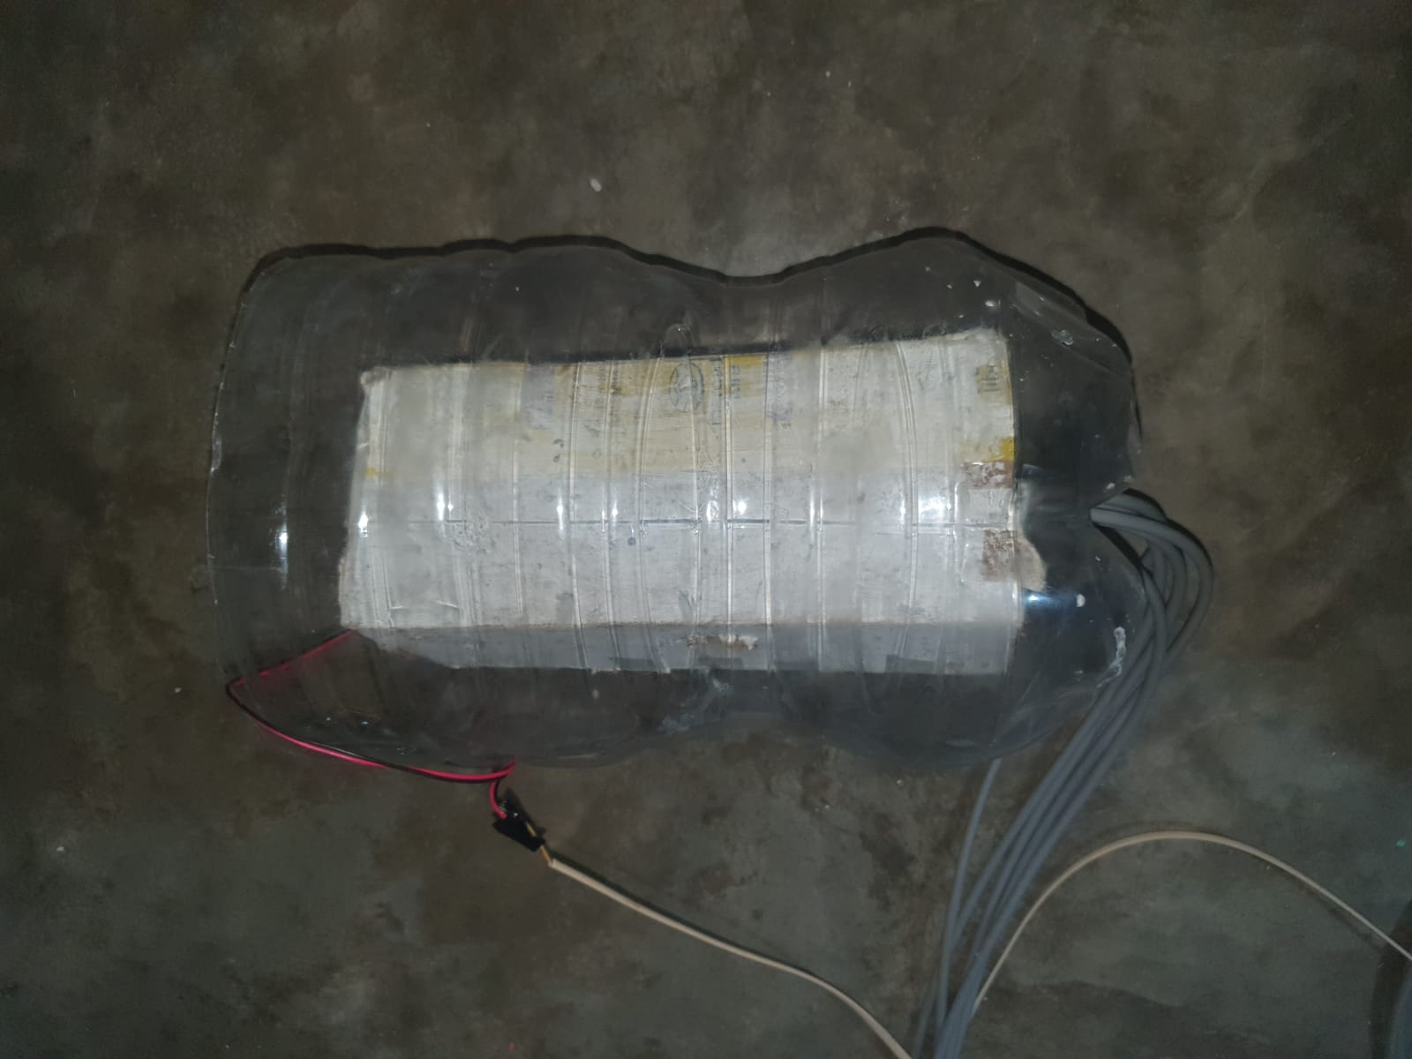
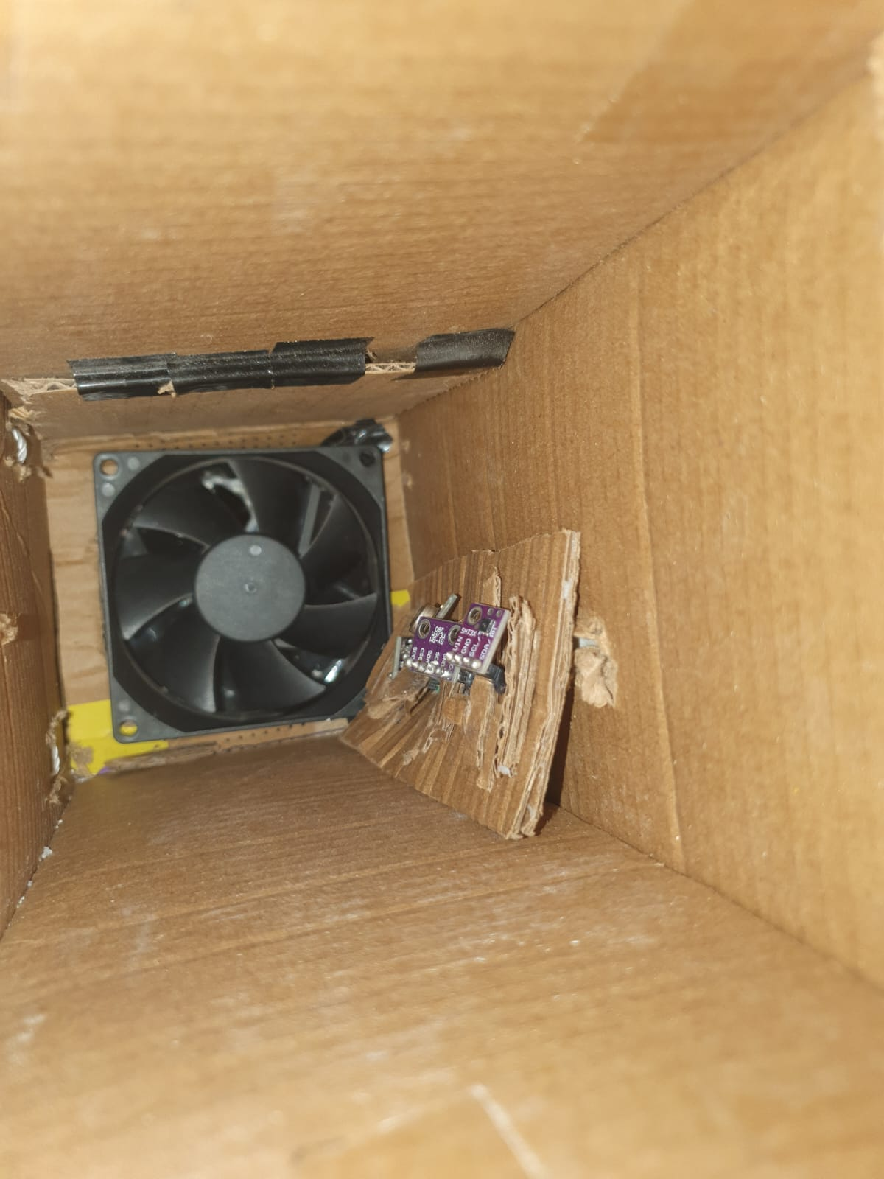
Materials Outside

Slide 5
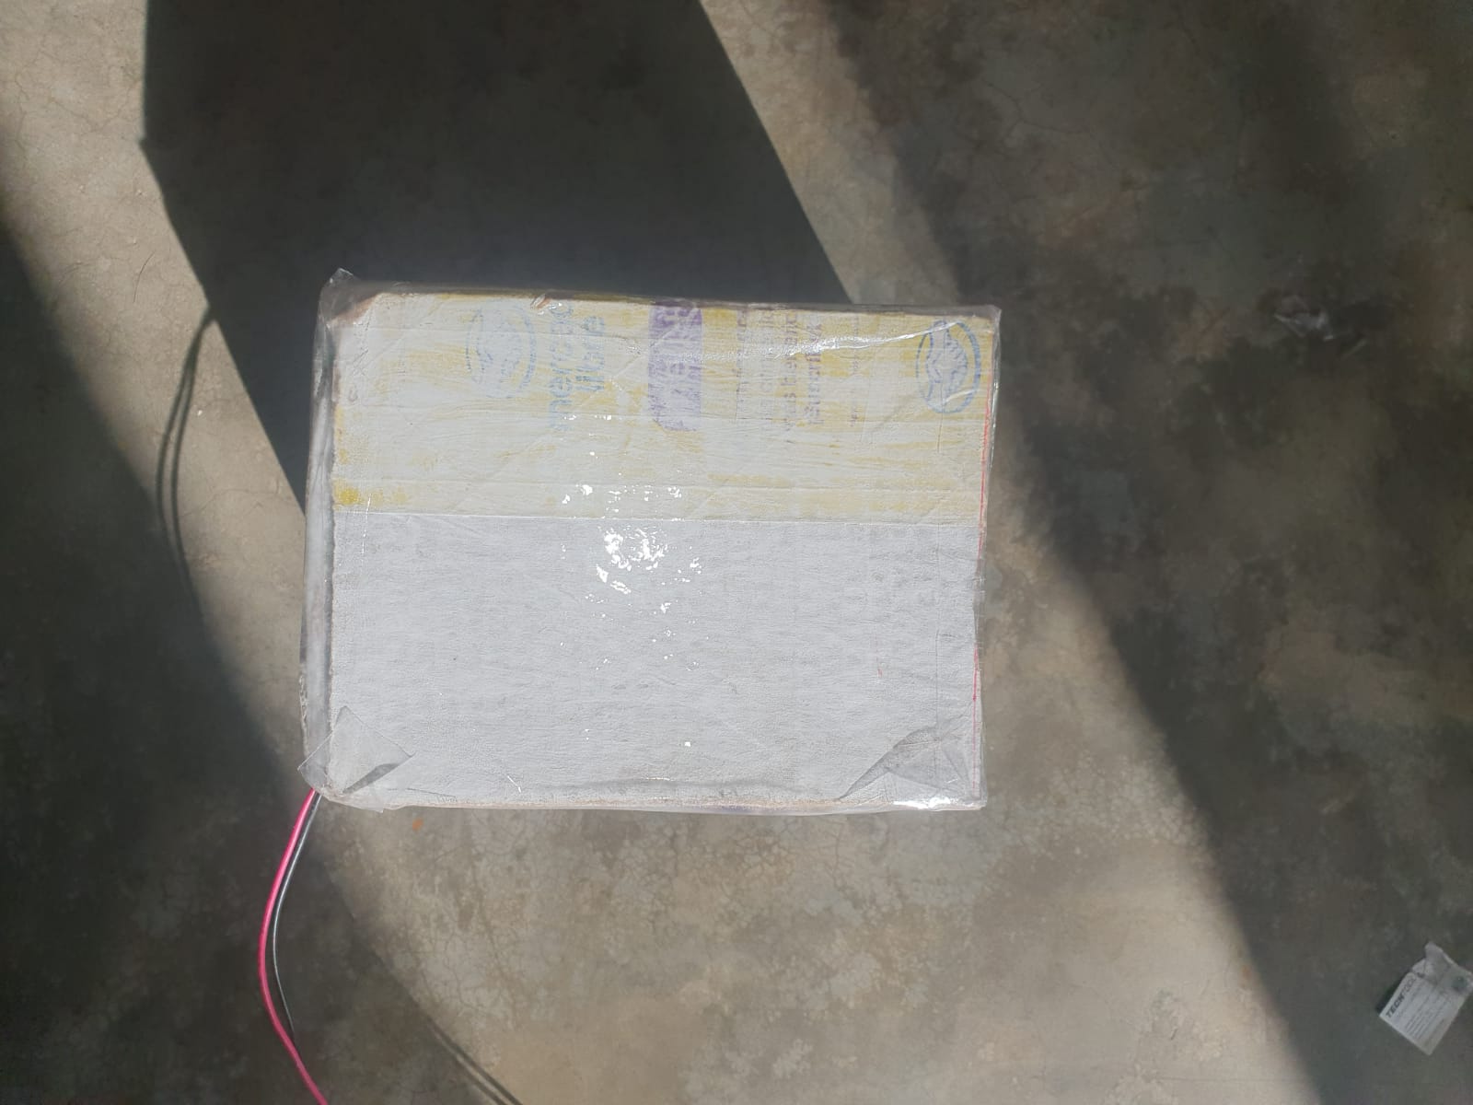
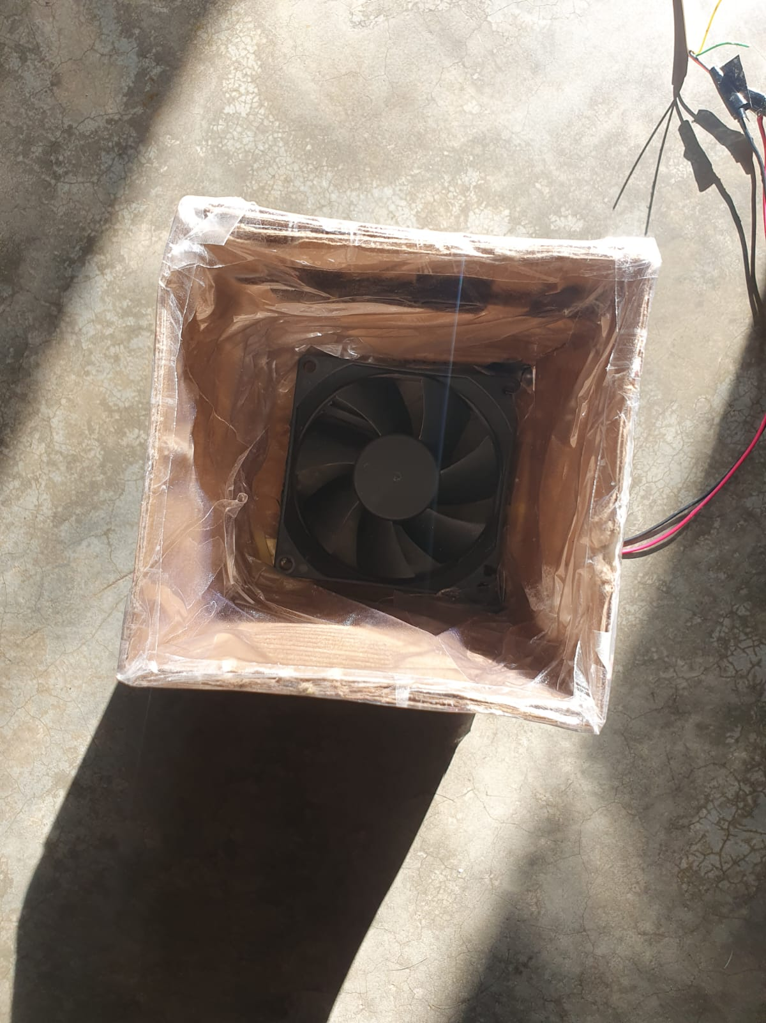
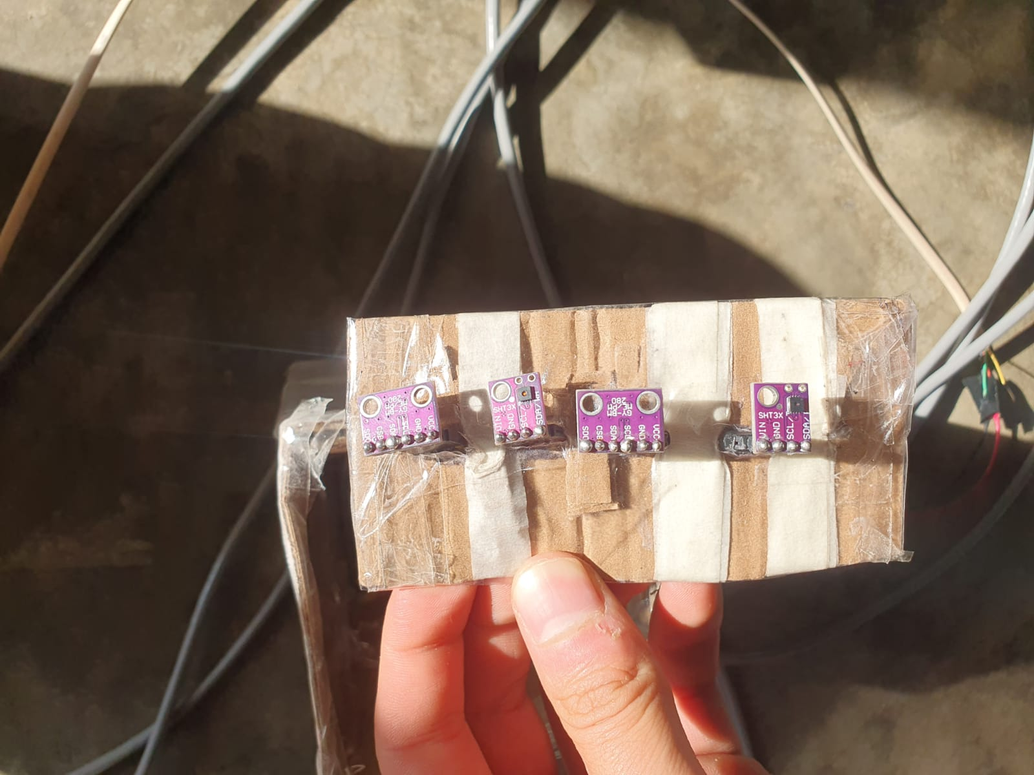
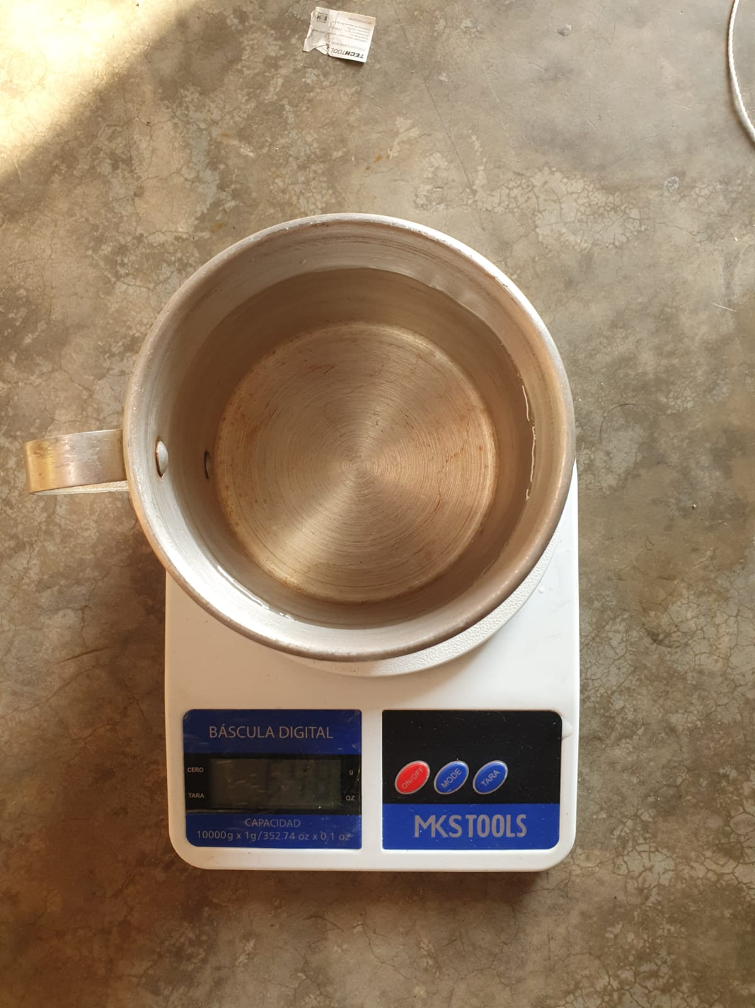
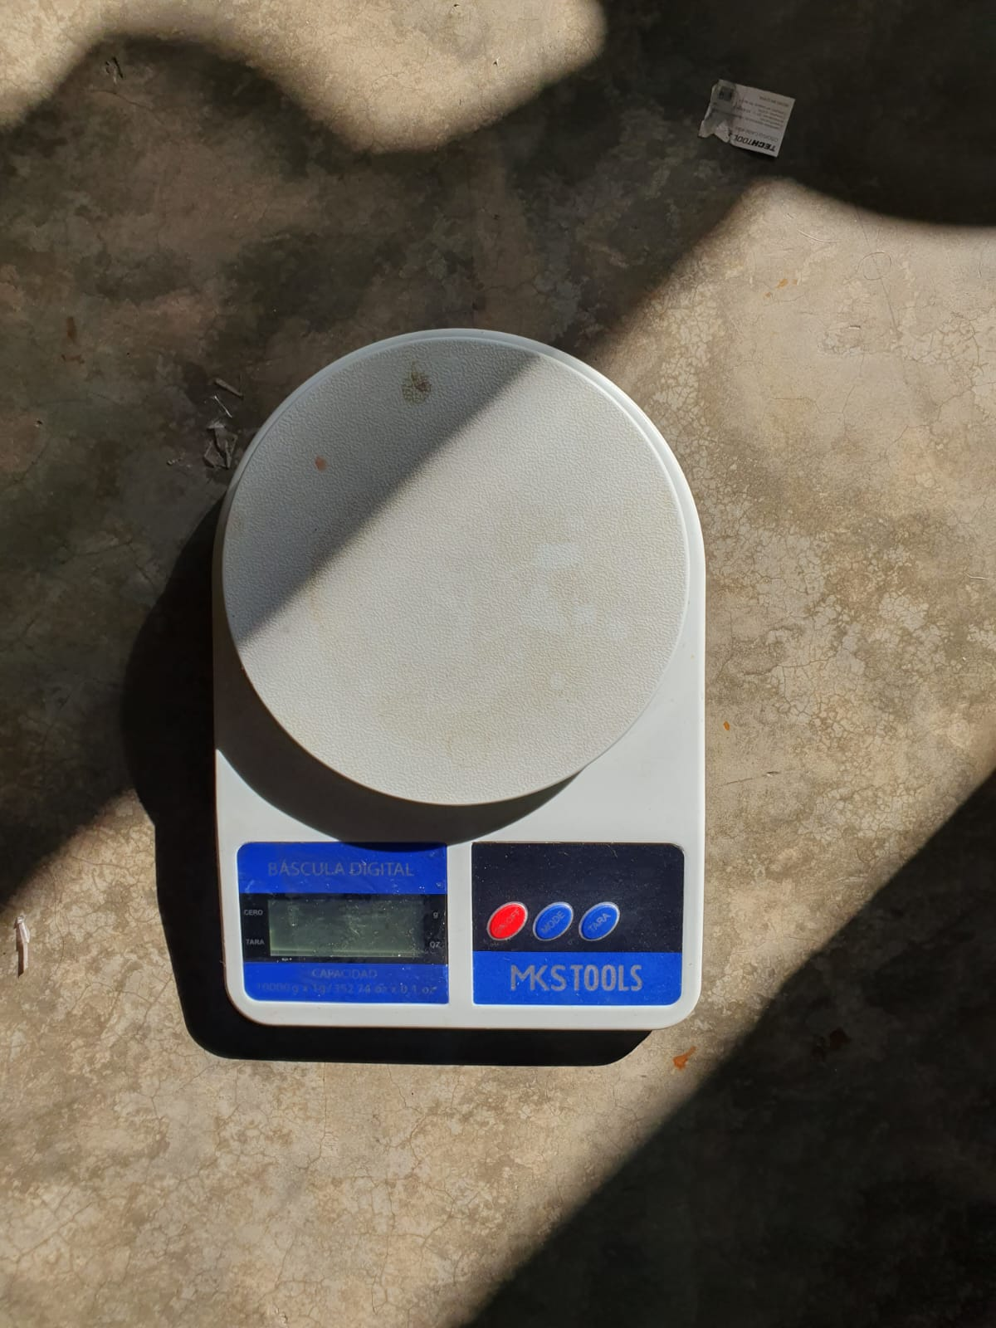
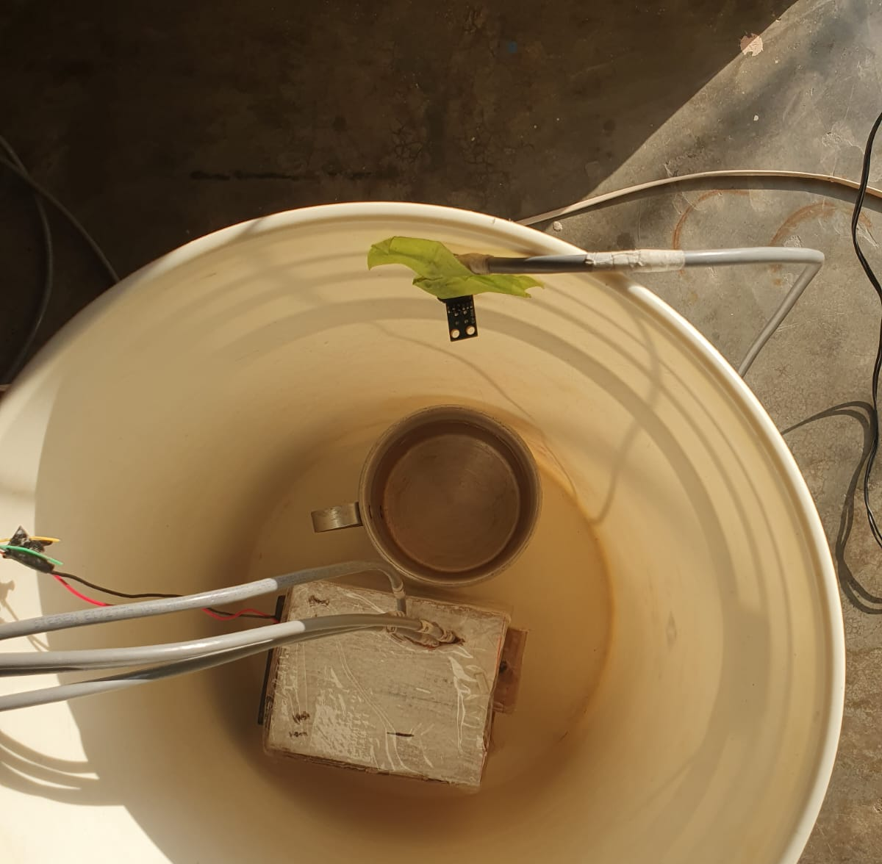
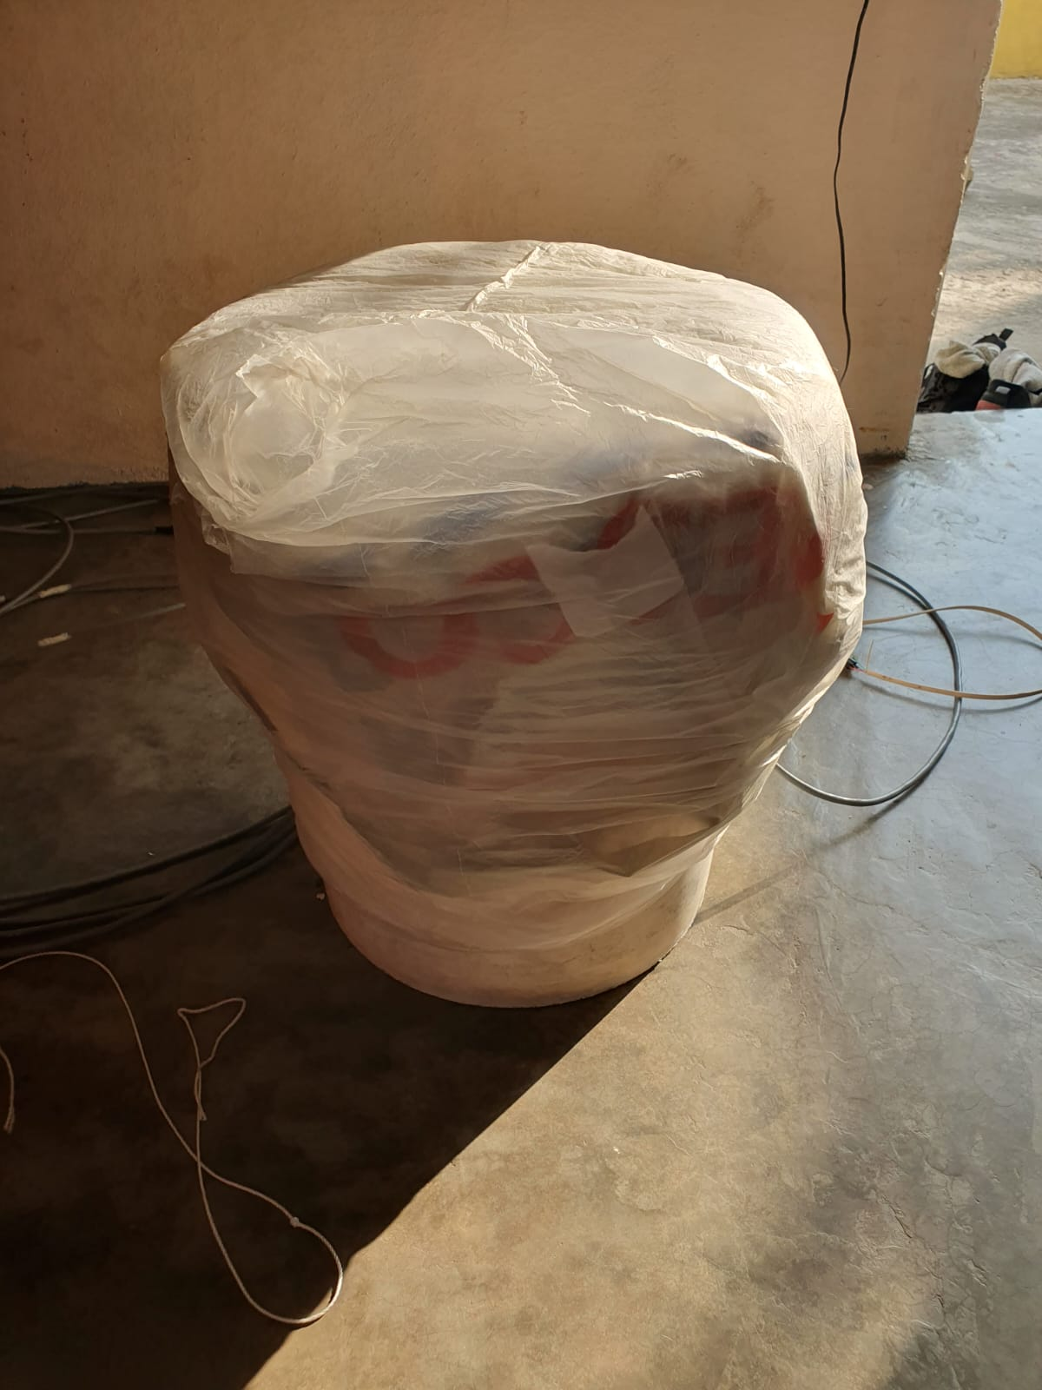
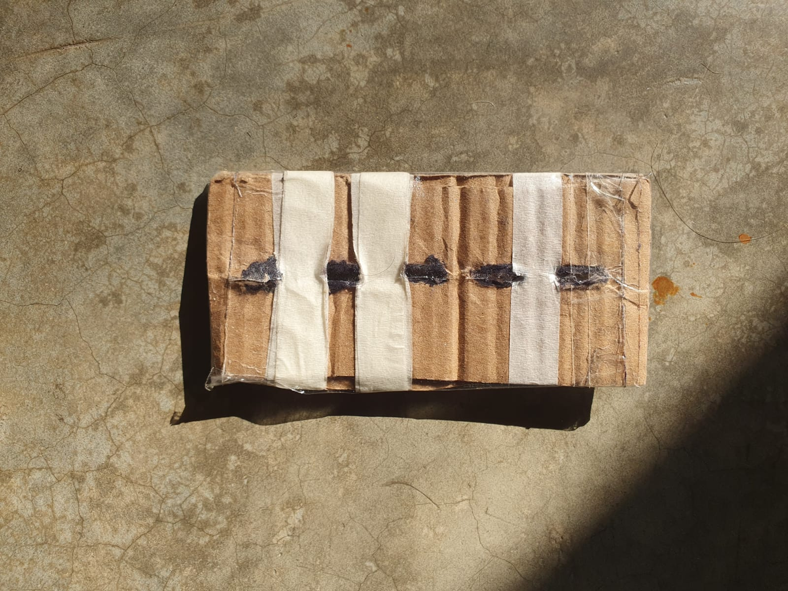
Materials Chamber

Slide 6
Comparing |E| between sensor of the same type
Readings between them

Slide 7
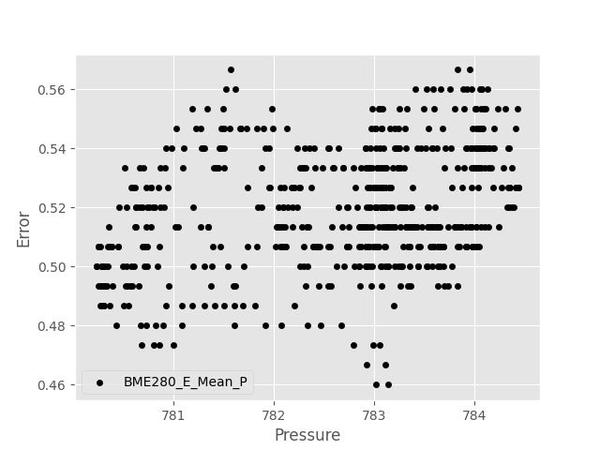
BME280 Pressure Room

Slide 8
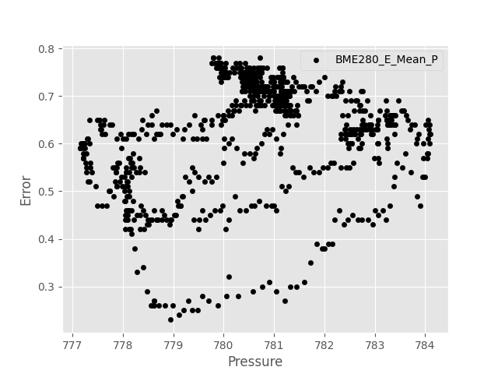
BME280 Pressure Outside

Slide 9
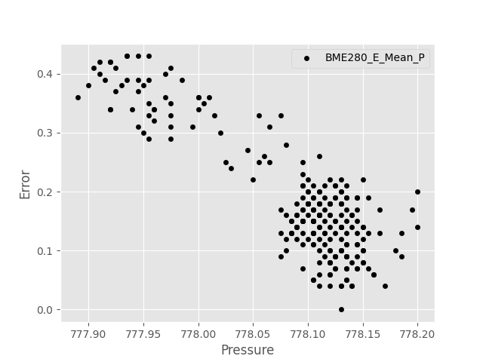
BME280 Pressure Chamber Time 1

Slide 10
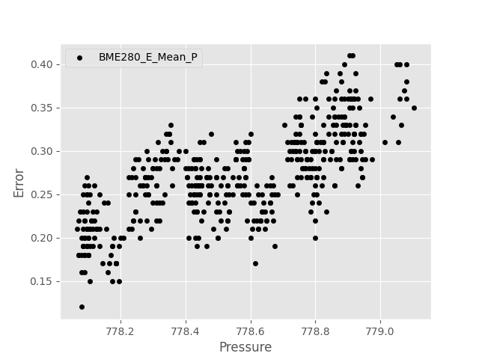
BME280 Pressure Chamber Time 2

Slide 11
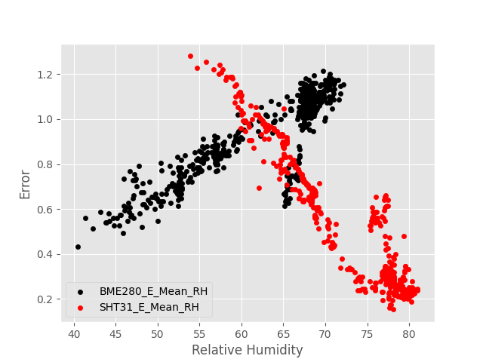
BME280 vs SHT31 Relative Humidity Room

Slide 12
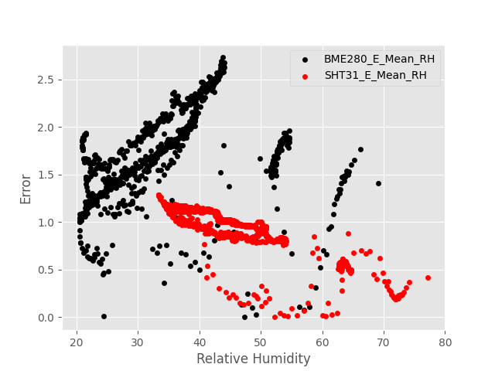
BME280 vs SHT31 Relative Humidity Outside

Slide 13
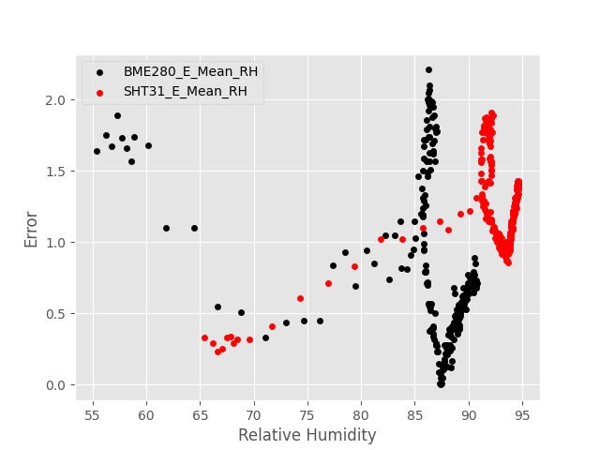
BME280 vs SHT31 Relative Humidity Chamber Time 1

Slide 14
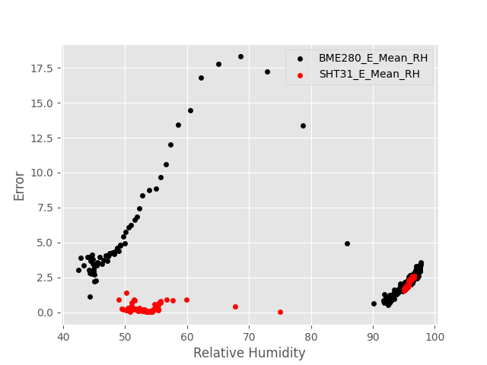
BME280 vs SHT31 Relative Humidity Chamber Time 2

Slide 15
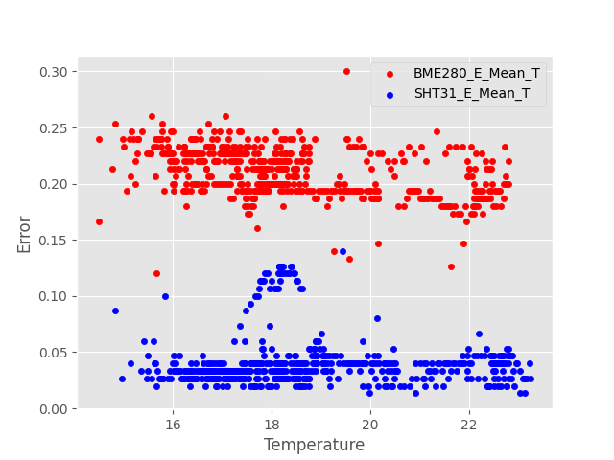
BME280 vs SHT31 Temperature Room

Slide 16
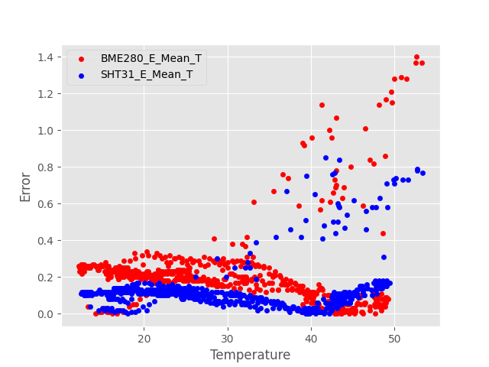
BME280 vs SHT31 Temperature Outside

Slide 17
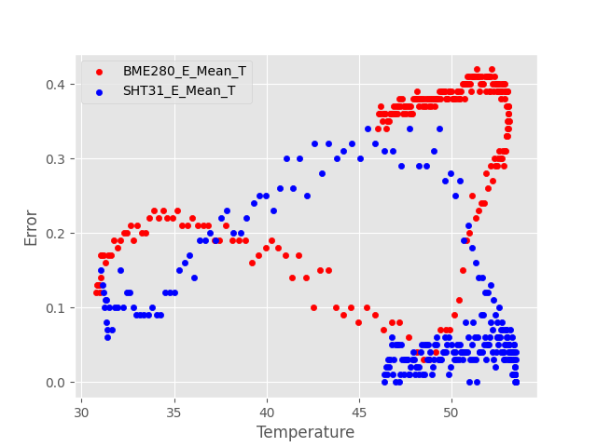
BME280 vs SHT31 Temperature Chamber Time 1

Slide 18
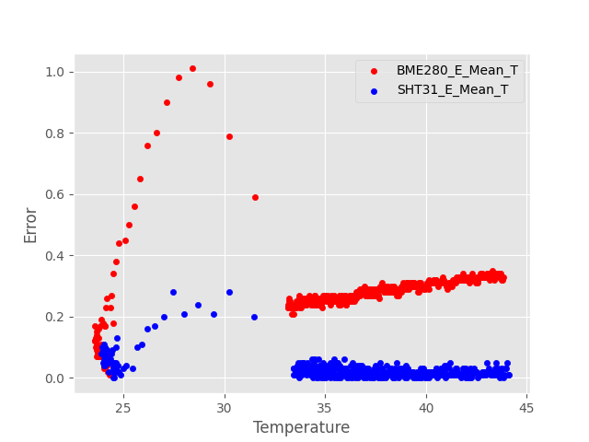
BME280 vs SHT31 Temperature Chamber Time 2

Slide 19
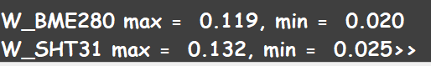
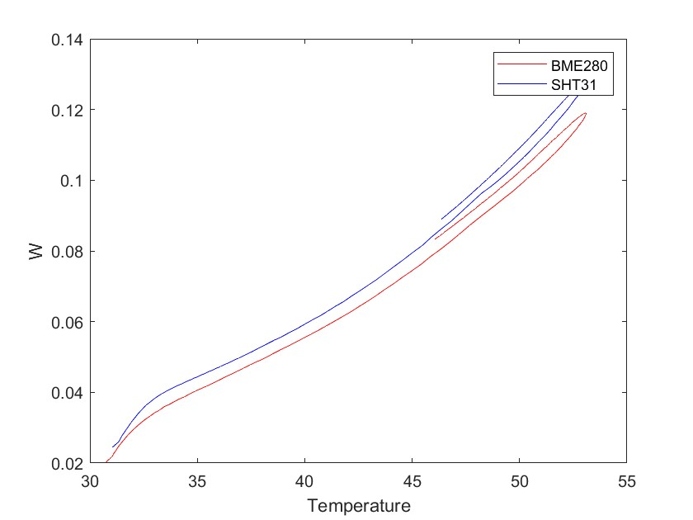
Time 1
From lower to higher

Slide 20
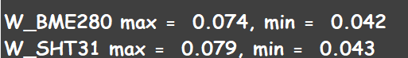
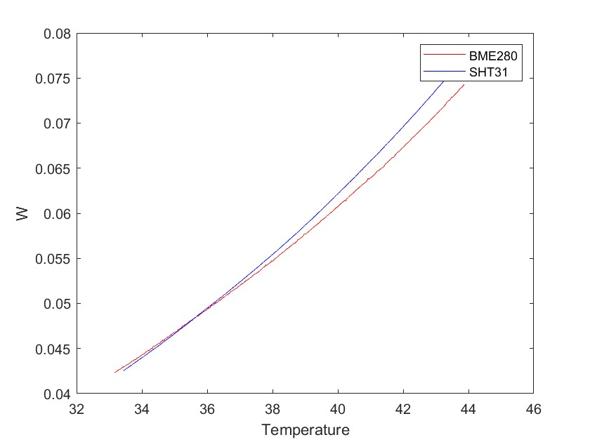

Slide 21

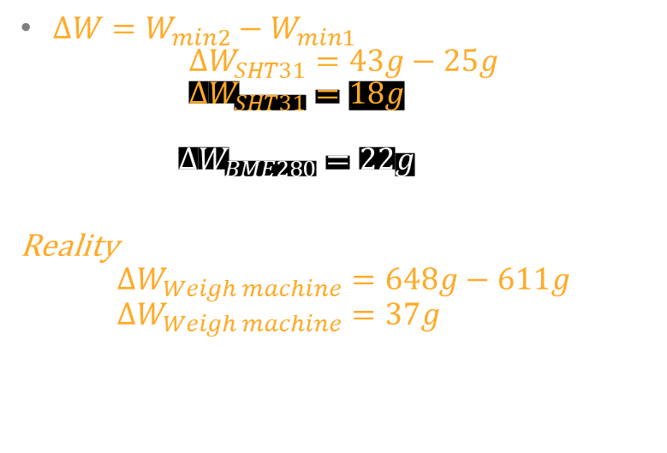
Difference
$ΔW=W_{min2}−W_{min1}$ $ΔW_{SHT31}=43g−25g$ $ΔW_{SHT31}=18g$
$$ΔW_{BME280}=42g−20g \\ ΔW_{BME280}=22g$$
Reality $$ΔW_{Weigh machine}=648g−611g \\ ΔW_{Weigh machine}=37g$$
What has it happened?

